Slide 1
Art Therapy & Leukemia
A presentation by Sinthia Cousineau

Slide 2
Why did I choose this topic?
A personal story:
-Chronic myeloid leukemia:
“cancer of the white blood cells”
Characterized by unregulated growth of predominantly myeloid cells in the bone marrow.
Hence, too many white blood cells.
Affects 14% of leukemia patients
More common in males

Slide 3
Common Symptoms of Cancer
It is important to consider the patients symptoms when conducting art therapy activities.
Symptoms can include:
-pain
-fatigue
-breathlessness
-insomnia
-lack of appetite
-anxiety

Slide 4
How Art Therapy can Help Cancer Patients
Can reduce cancer symptoms
Art therapy is considered a complementary therapy, which controls a patient’s symptoms and improves their overall well-being.
Art Therapy can:
-help patients by reinforcing positive coping behaviour
-increase their self-esteem
-increased a sense of control.
-Strengthen self-identity
-promote spiritual and emotional well-being

Slide 5
How Art Therapy can Help Cancer Patients
-decrease anxiety
-reduce stress, which aids in pain management because it distracts patients from their pain.
-can help patients express their fears
-encourages patients to talk about their problems.

Slide 6
Article 1: Approaches to Art Therapy for Cancer Inpatients: research and practice considerations
Nainis, N. (2011), former Director of Expressive Arts Therapies with the Oncology & Palliative care unit in Northwestern Memorial Hospital.
She gives advice on factors to consider as an art therapist:
Infection Control:
-Cancer patients have low immunity and can be very vulnerable to minor infections.
-Thus, it is best to not bring the art cart into the patient’s room to avoid contamination.

Slide 7
Article 1: Approaches to Art Therapy for Cancer Inpatients
2) Use Odorless materials:
-cancer patients are very sensitive to smells, which can trigger nausea or headache.
-Avoid using perfumes, strong smelling cosmetics or aromatic cleansers.
3) Avoid possible interruptions:
-schedule therapy session by discussion with medical staff
4) Keep the art therapy interventions as consistent as possible:
-give patients choice in choosing their materials to foster a sense of self-control

Slide 8
How illness can affect patients
Having cancer can challenge the following aspects of a patient’s life:
Finances: medical pills are very expensive
Relationships:
-no energy for social life
-depression can cause family depression too
-inability to work.
Challenges Beliefs:
-Asking yourself “why me”, questioning yourself to what you have done to deserve it.

Slide 9
How has cancer affected me?
My perspective as someone who knows someone who faces the challenges of cancer:
-Thinking & preparing for the possibility of death.
-Constant worry
-Feeling helpless
-Sadness & depression
-Guilty
I have noticed that I unconsciously reflected these negative feelings in my art throughout the years:
-skulls
-tears
-bones
-darkness
-grief

Slide 10
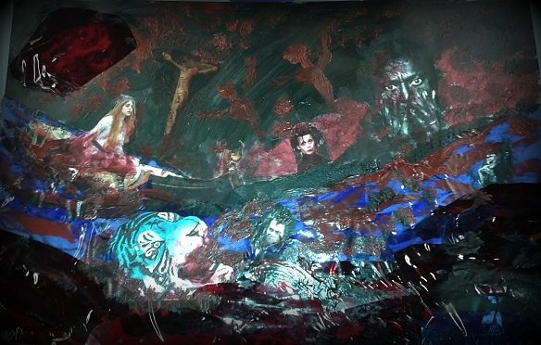
My Art…..my pain

Slide 11
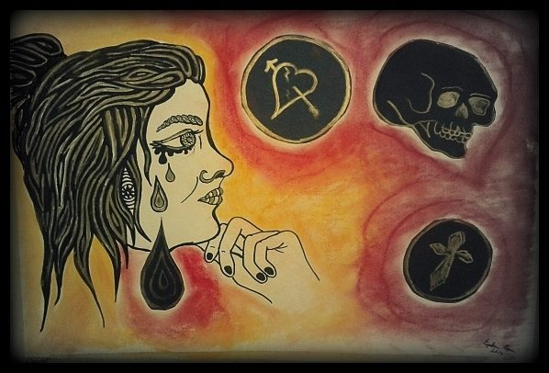
Grief ….anxiety….worry

Slide 12
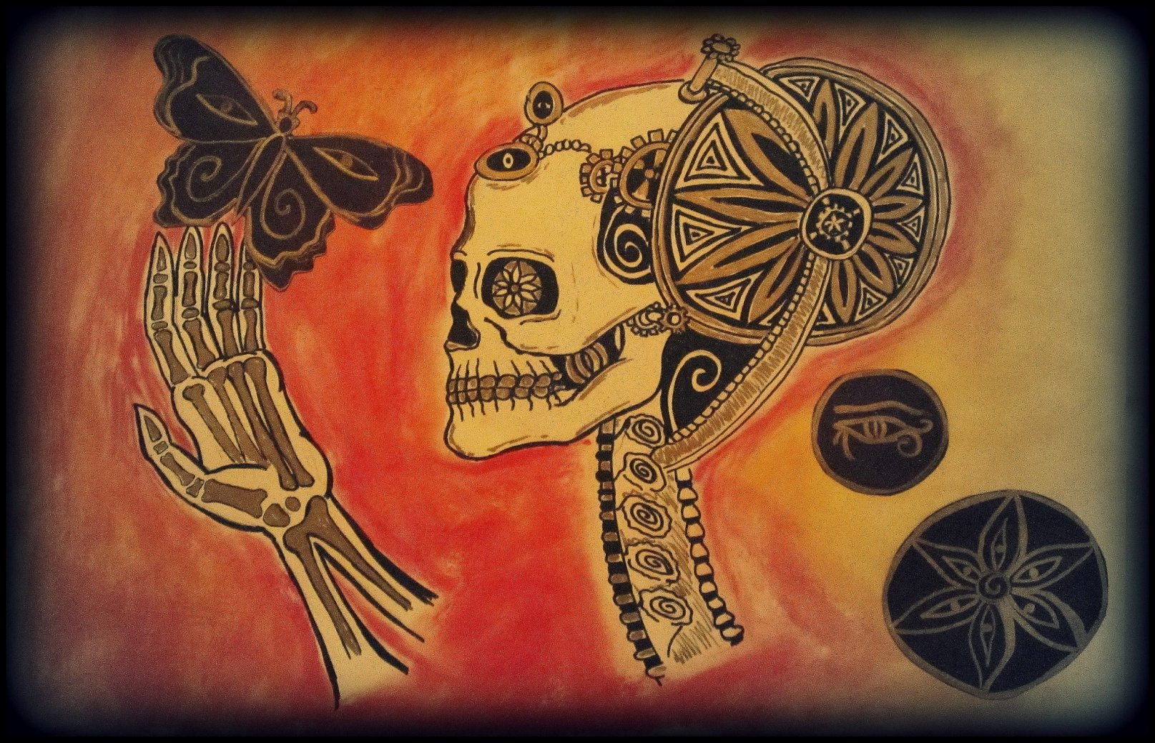
Freedom from Death

Slide 13
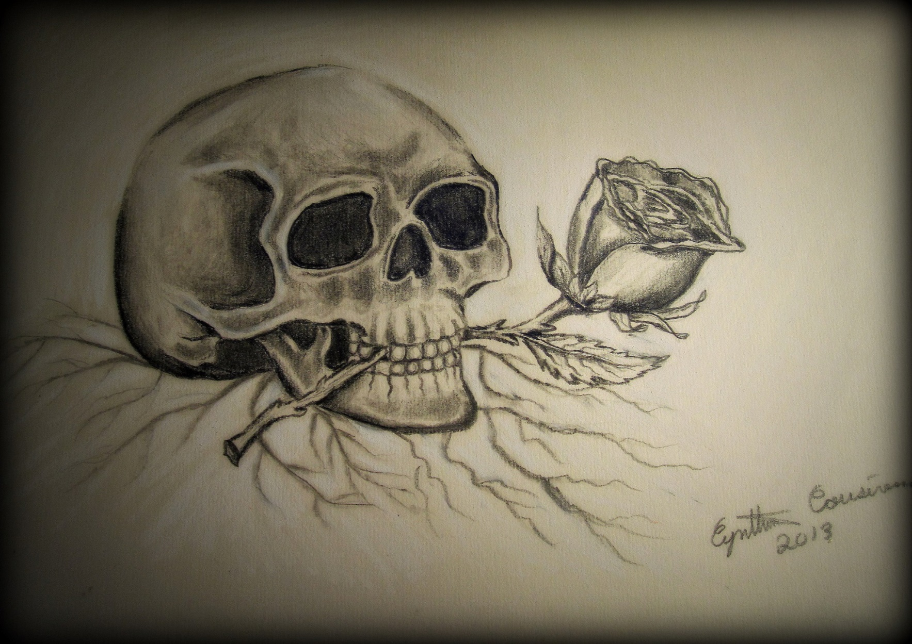

Slide 14
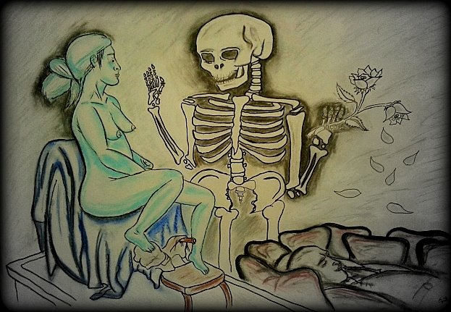
Comforting Death

Slide 15
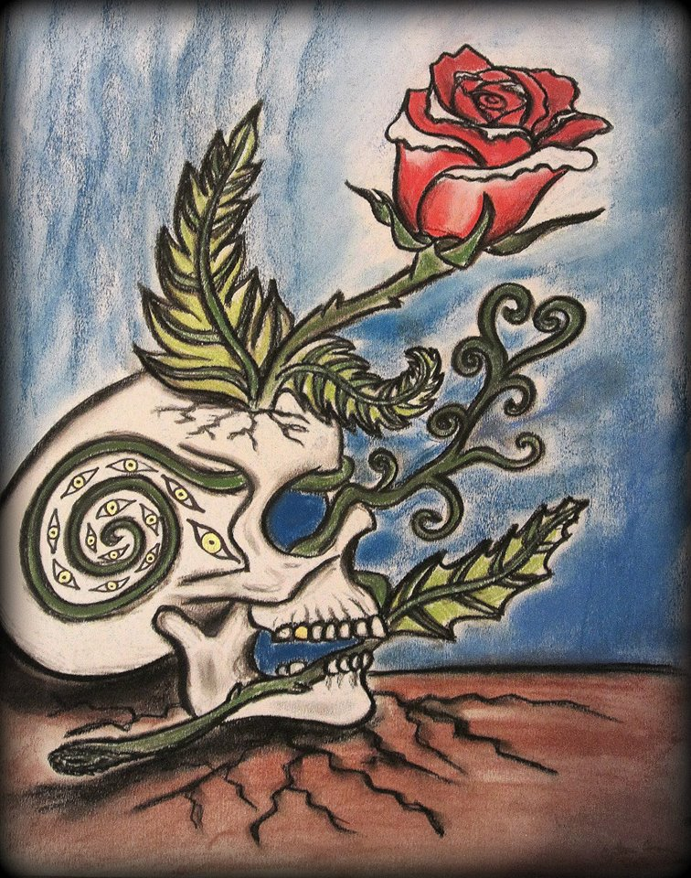
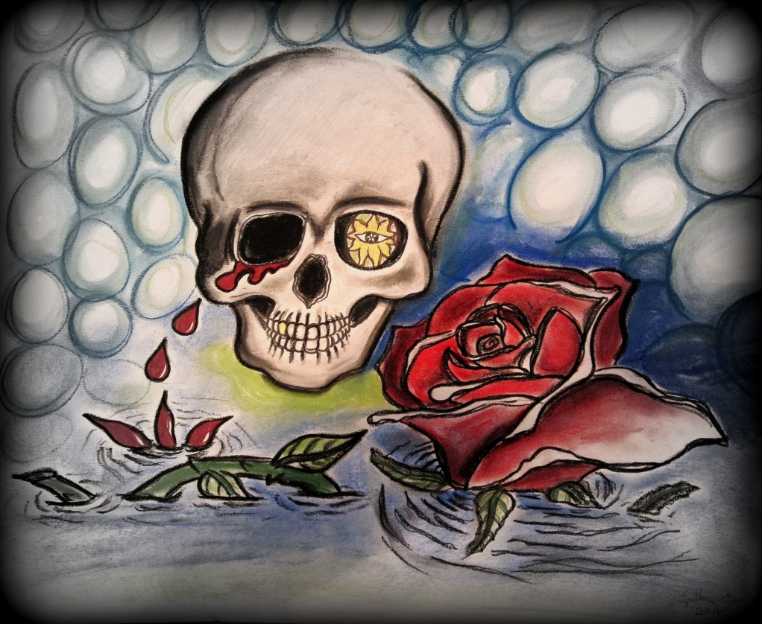
Skulls

Slide 16
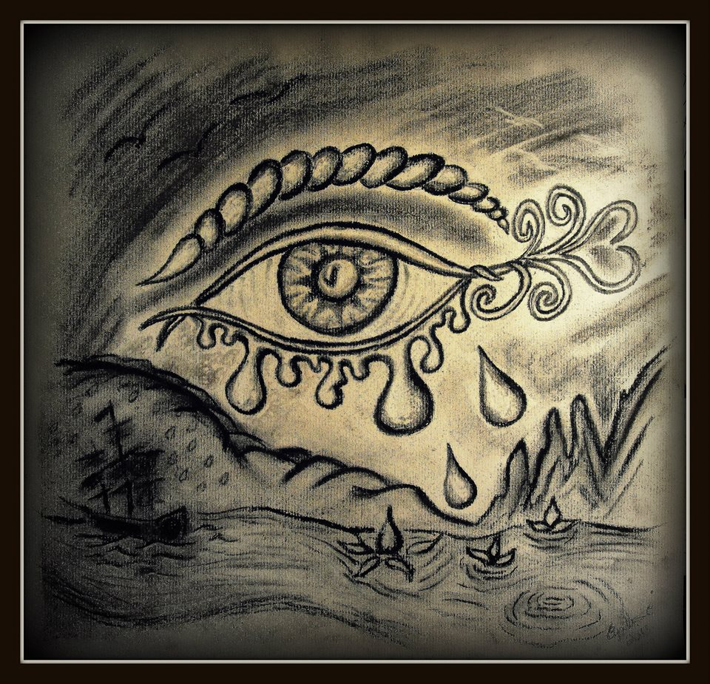
Tears or Sadness

Slide 17
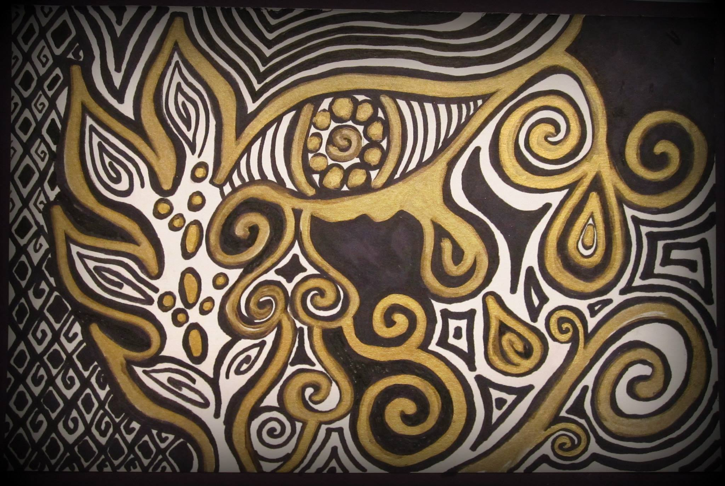

Slide 18
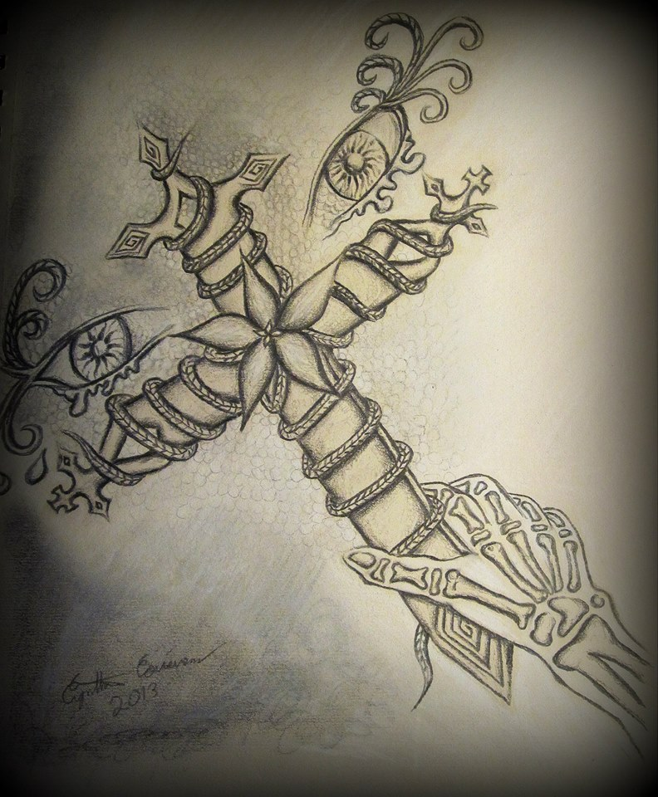
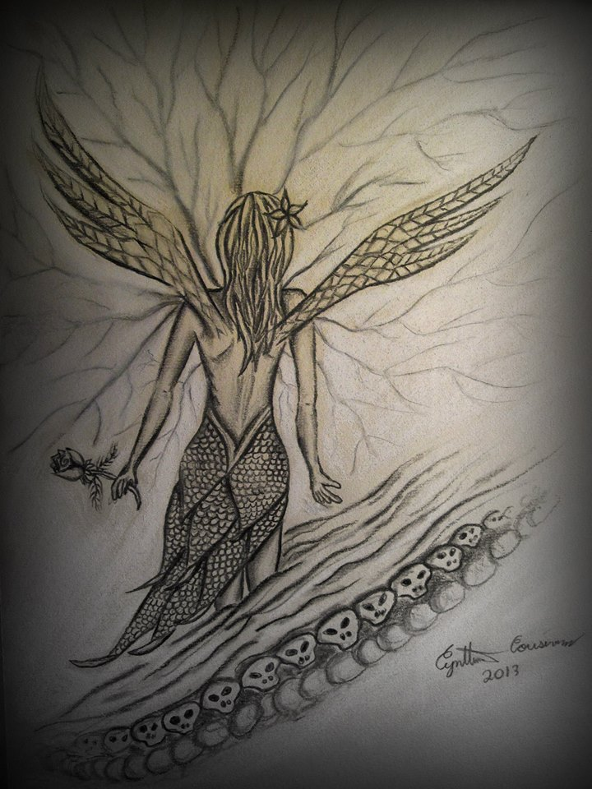

Slide 19
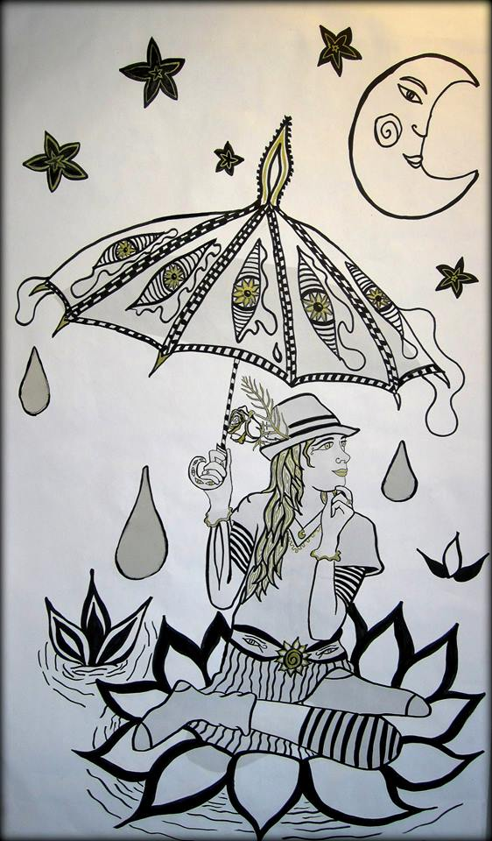
Thanks for Listening

