Slide 1
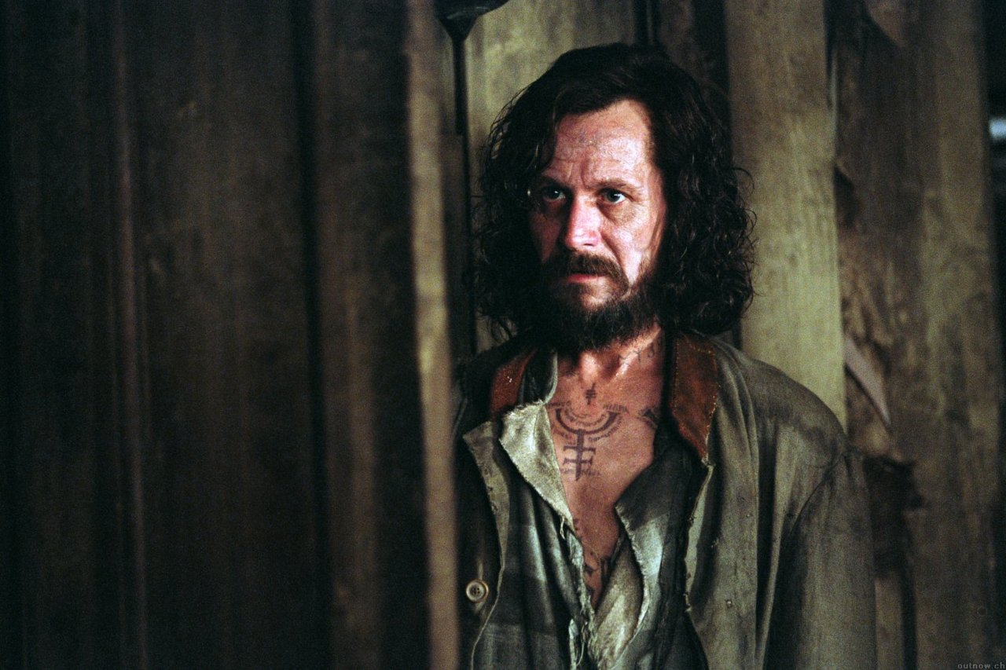
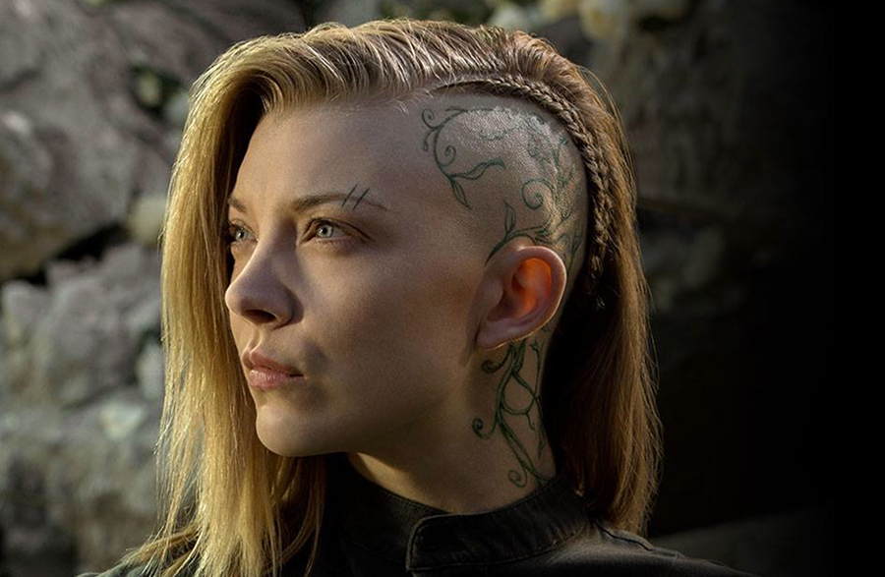
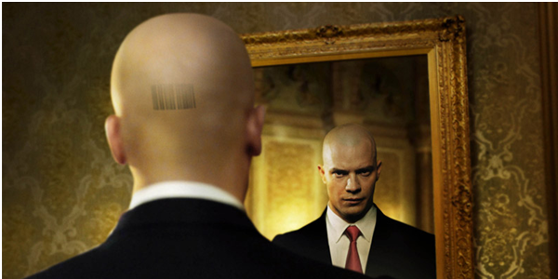
Tattoo Art
Is it art?

Slide 2
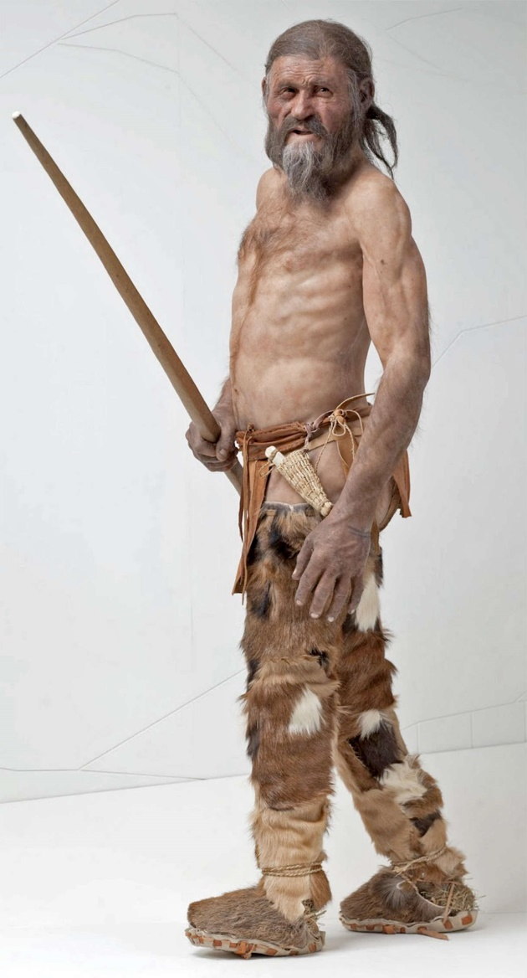
Earliest Tattoos
Tattoos date back as far as the Neolithic era, or around the 4th to 5th millennium BC.
The oldest discovery of tattooed human skin to date is found on the body of Ötzi the Iceman, dating to between 3370 and 3100 BC
Notes:
Tattooing has been practiced throughout the world for many centuries.
Archeological evidence found on the bodies of ancient mummies.
The Ainu (Indigenous people of Japan) had facial tattoos.

Slide 3
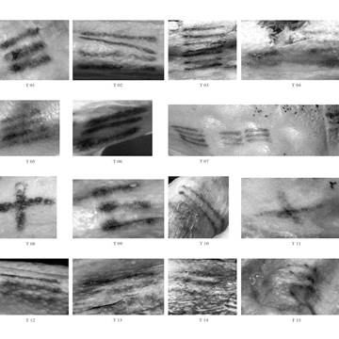
Simple Line tattoos
Otzi’s Knee

Slide 4
Possible Neolithic tattoo marks depicted clay figure from Romania, ca. from 7000 yrs. Ago.
Notes:
Possible Neolithic tattoo marks depicted on a Pre-Cucuteni Culture clay figure from Romania, ca. 4900-4750 BC.

Slide 5
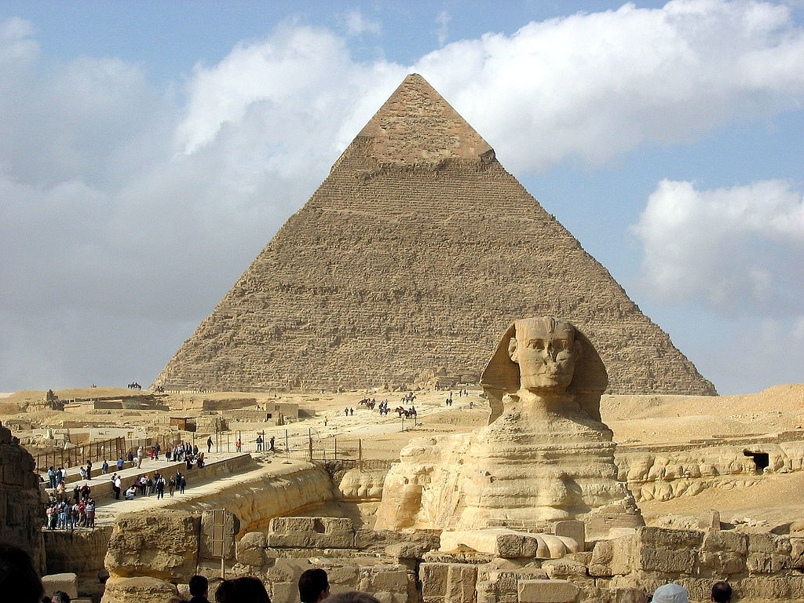
Funeral Art & Religion
Tattoos are applied so that the spirit is allowed to pass into the spirit world undisturbed by evil.
Found on female mummified bodies from 4000 yrs. ago.
Tattoos are still used to create a spirit connection with deceased loved one and family members.

Slide 6
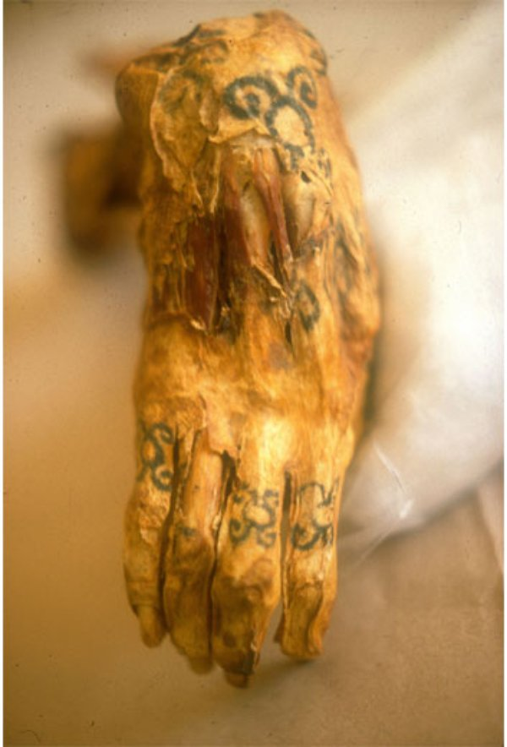
Egypt
Most of the tattoos were found on the bodies of women.
They were used as part of treatment for healing purposes.
Images of fertility were shown on women’s bodies, as a treatment to help them have more kids.
Mummy’s Hand

Slide 7
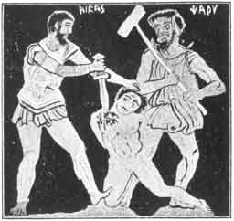
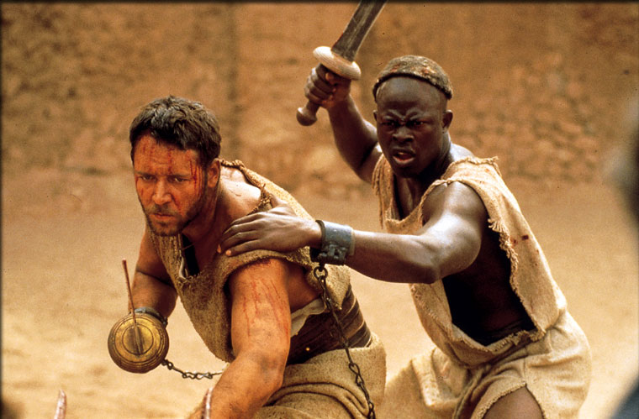
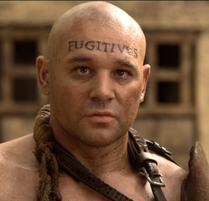
Ancient China, Greece and Rome
Tattoos considered a barbaric practice.
Applied on face of prisoners. Used to identify criminals.
Applied on slaves to show ownership.

Slide 8
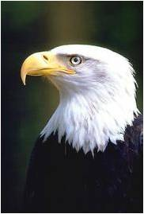
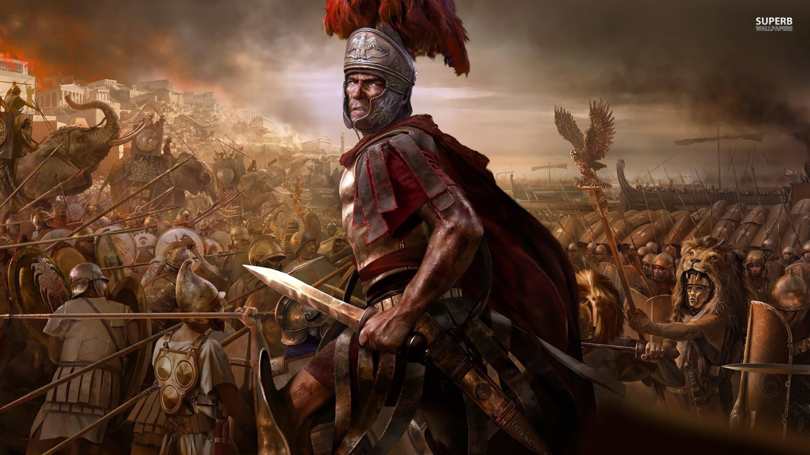
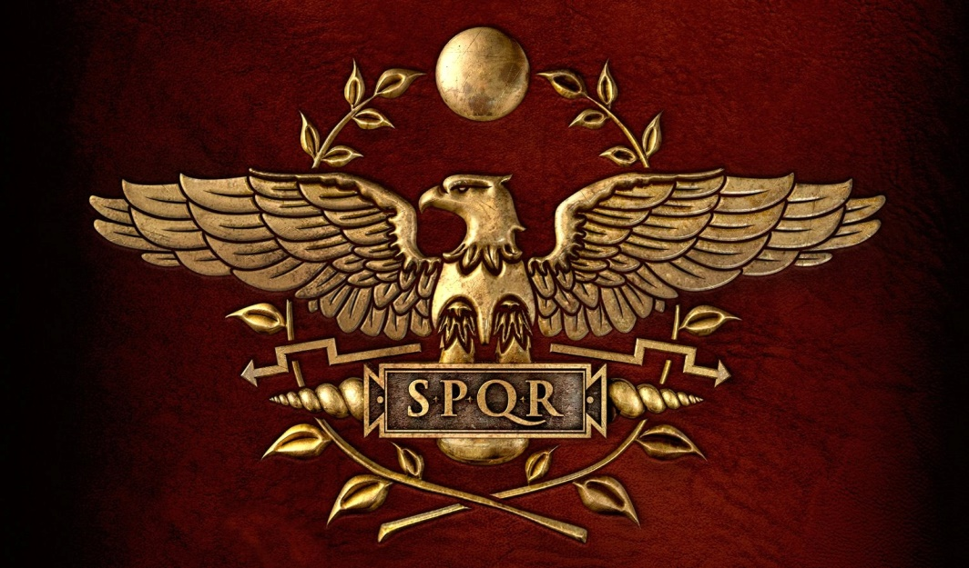
The Romans
Military Tattoos
SPQR that was tattooed onto the arm of a legionary, to discourage desertion.
Latin phrase= Senātus Populusque Rōmānus ("The Senate and People of Rome“)
Eagle= Symbol of Roman Legion & Power
Symbol of spirit & connection to the divine

Slide 9
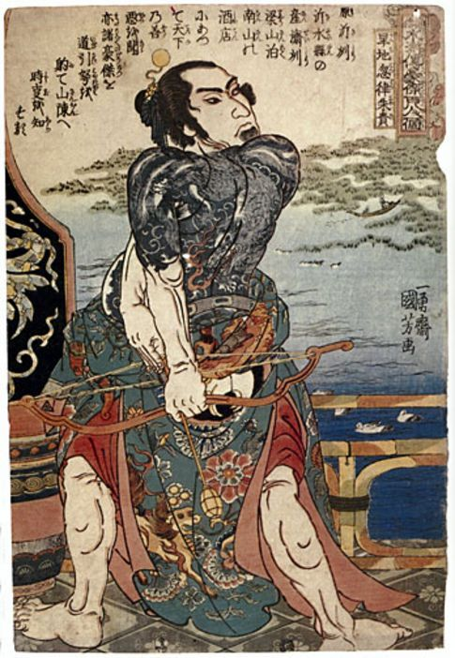
Japan
Spiritual purpose and for decoration.
Began in 10,000 BCE with the Japanese native culture called “Ainu”.
Criminals were widely being tattooed as a visible mark of punishment
Traditional Art: Samurai Warrior with Tattoos

Slide 10
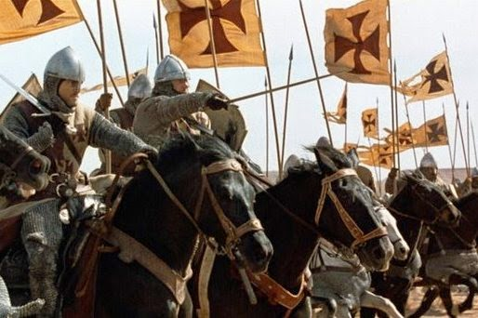
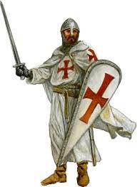
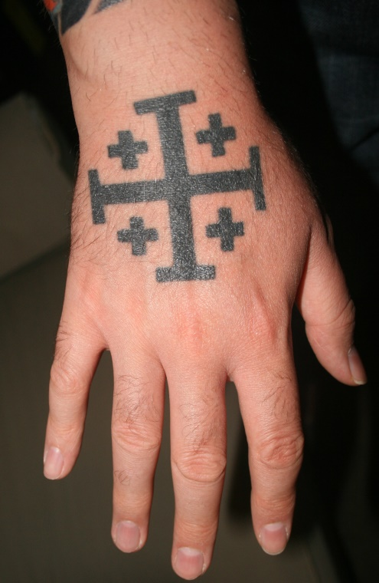
Medieval Crusades
During the Crusades (11th and 12th centuries), warriors identified themselves with the mark of the Jerusalem cross.
So that they could be given a proper Christian burial if they died in battle.

Slide 11
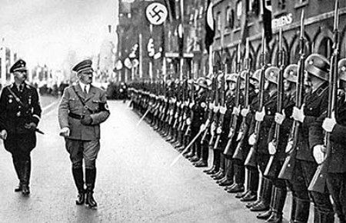
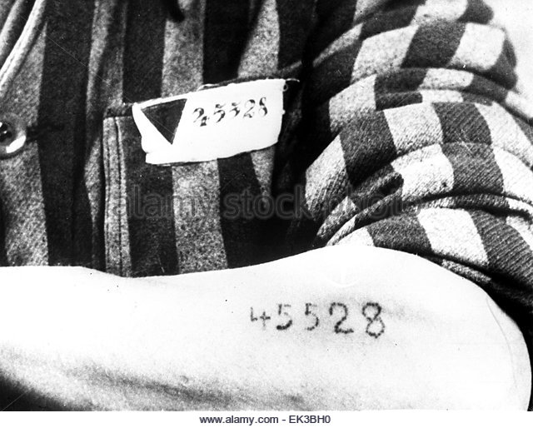
The Nazis
Would tattoo the numbers on the chest or arms of prisoners at concentration camps.
Done to their prisoners to identify their bodies.
After the war the survivors would show off their tattoos as a symbol of the crime it represented so people don’t forget the history.

Slide 12
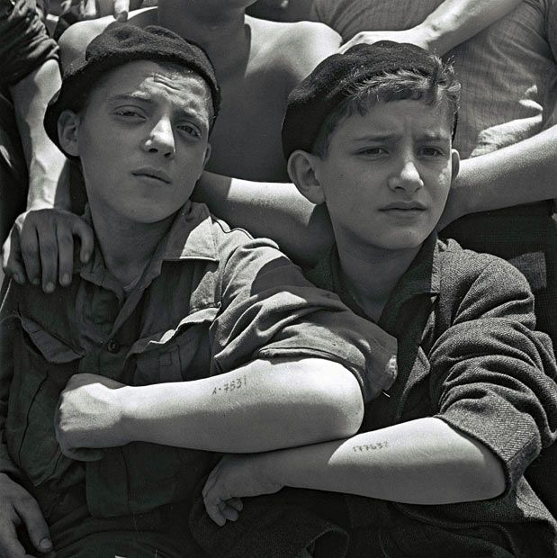
Jewish children rescued from Auschwitz show their tattoos (age 14-15yrs)

Slide 13
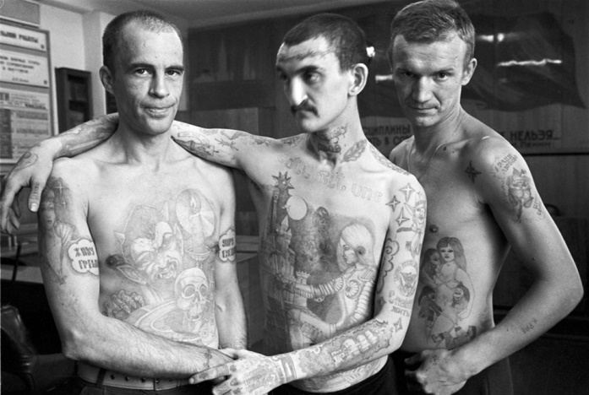
Russia
Known to have one of the most criminal activities.
Everyone knows someone who has been imprisoned, and prisons are over crowded.
Each prisoner has a tattoo, for tattoos represent their stories and crimes committed.
Tattoos shows status among prisoners in the prison system, and if you have no tattoos you are considered worthless. Your survival depended on your tattoos.

Slide 14
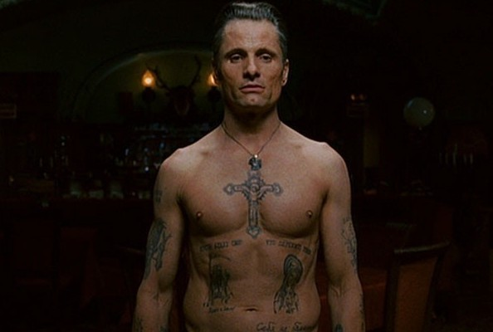
Eastern Promises

Slide 15
Recognize this prisoner?

Slide 16
USA
1846 German man, Martin Hildebrandt sets up New York’s first tattoo shop on Oak Street in lower Manhattan
Popular with sailors & the military
Tattooed sailor aboard the USS New Jersey in 1944

Slide 17
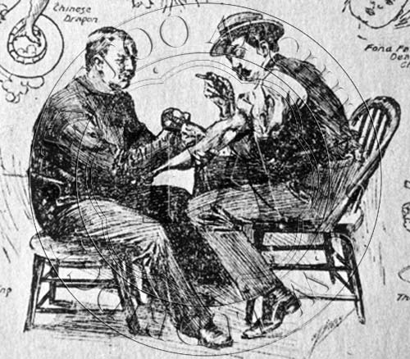
Modern Times
Modern tattooing began in 1891 in New York City with the invention of the rotary tattoo machine by Samuel O'Reilly.
Inspired by Thomas Edison’s inventions: the autographic printing pen

Slide 18
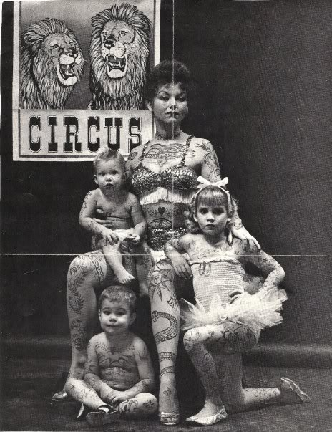
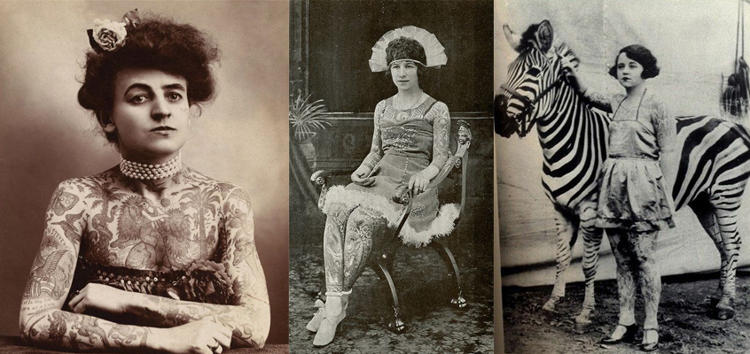
Circus Freaks
By the end of the 1920s, American circuses employed more than 300 people with full-body tattoos who could earn an unprecedented $200 per week.

Slide 19
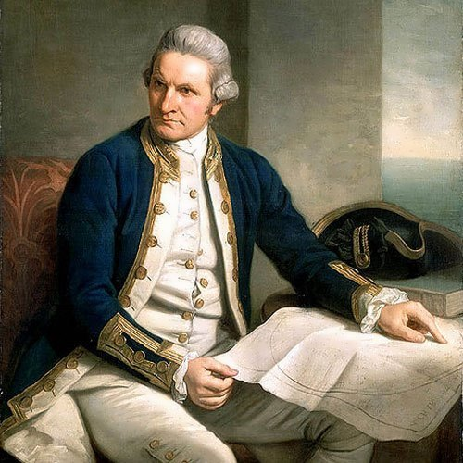
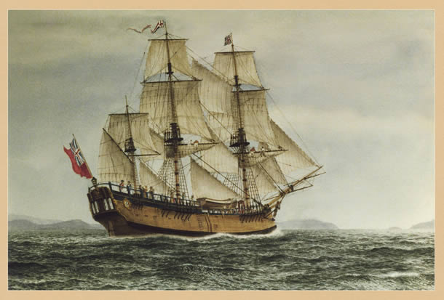
Origin of the Word
The word tattoo comes from the Polynesian word tatau from Tahiti, meaning "correct, workmanlike".
1769, an English Captain called James Cook landed on the island and saw many indigenous people with tattoos…..his crew later got tattoos of their own….to represent their travels around the world.

Slide 20
Why do People get tattoos?
1) To honor the memory of family or loved one.
2) A symbol of their identity & personality.
Example: your zodiac sign or spirit animal
3) It is art:
a form of expression.
They have symbols that mean something to them.

Slide 21
Sirius Black
Shown with tattoos as a sign that he has been imprisoned

Slide 22
Popular Culture
Agent 47s barcode tattoo is an essential part of his character; both in the video game series and the 2007 film.
The barcode tattoo on the back of his head is the only aspect of his appearance which he could be identified with.
Notes:
The master assassin is the human equivalent of a blank canvas; bald, blue-eyed and always wearing a plain, unremarkable suit. This is to allow him to be inconspicuous in a crowd and to don disguises when needed.

Slide 23
Pirates Of The Caribbean: The Curse of the Black Pearl (2003)
Identity as gang member of the high seas & status as a captain

Slide 24
Star Wars: The Phantom Menace (1999)
According to Star Wars-mythology, Maul is a Dathomirian Zabrak who was branded with agonising Sith tattoos by Darth Sidious as a ritualised display of the apprentices commitment to the dark side

Slide 25
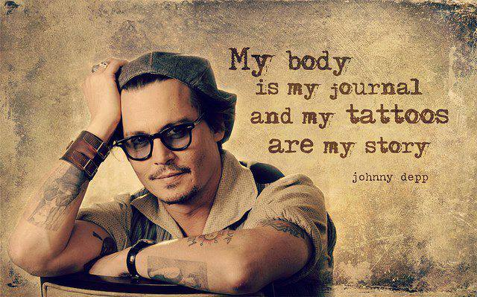
Lesson Design your own Symbolic Tattoo
Step 1: In your sketchbook write the answers to the following questions:
What makes you special?
What part of your personality stands out the most to you?
What symbol relates most to your personality?
What element of your past would you represent in an image?
Step 2: Design (draw) at least 3 a basic composition of a tattoo idea that represents your identity & uniqueness.
Step 3: Once approved by the teacher, usingthe paper provided redraw your image using ink.

Slide 26
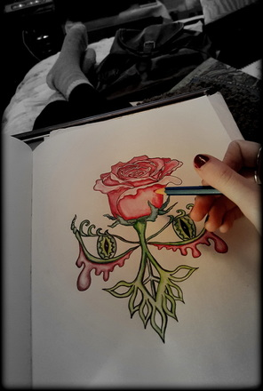
My Symbolic Tattoo Design

Slide 27
Part 2
Tribal Tattoo Design

Slide 28
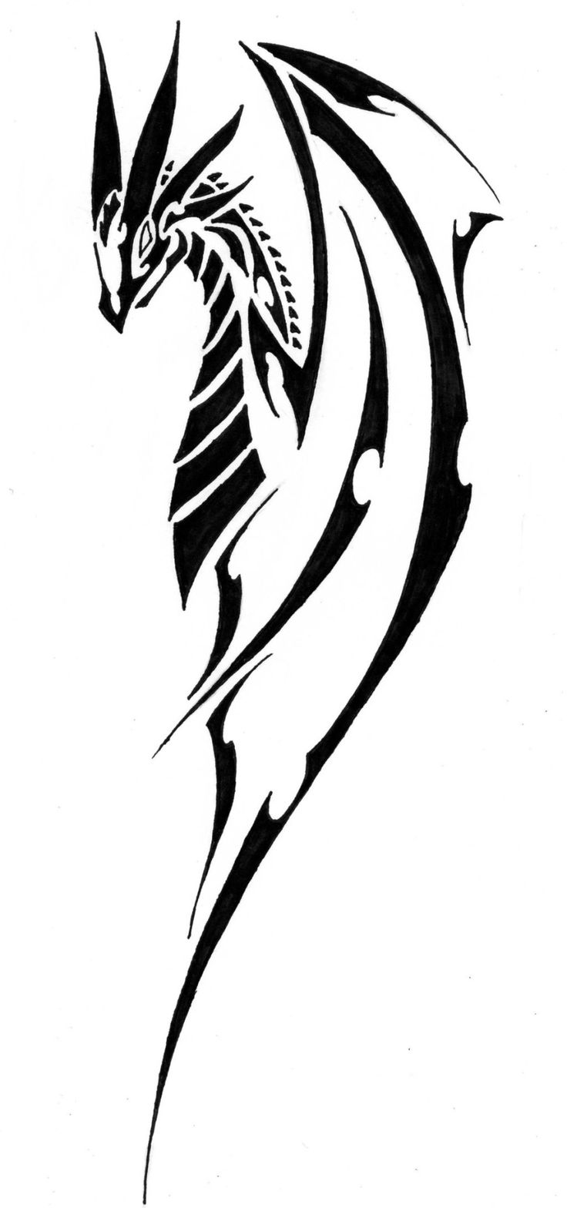
Tribal Tattoos
Characteristics:
Often identified by their curved lines, points and decorative patterns.
Divided into parts that do not touch each other.
Symbolizes something often an element of nature

Slide 29
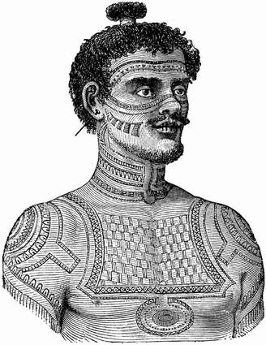
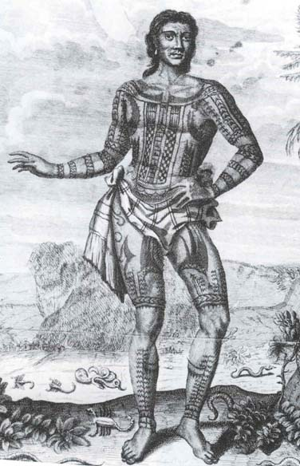
Tribal Tattoos
Originated from tribes in Africa, Australia and the Polynesian islands.
Meaning was originally spiritual.
Teenagers from these tribes would get initiated into adulthood with a tattoo, and each tattoo symbolized something. Inspired by elements of nature or the natural elements

Slide 30
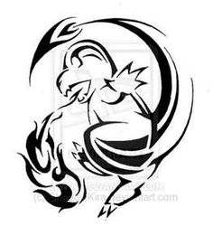
Examples
An image divided into parts, and none of the parts touches the other.

Slide 31
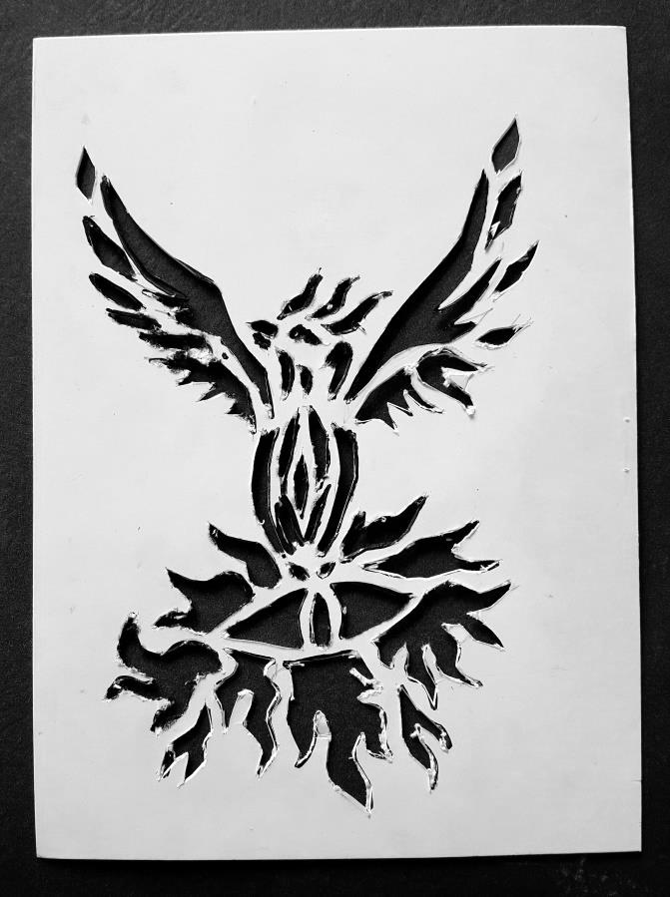
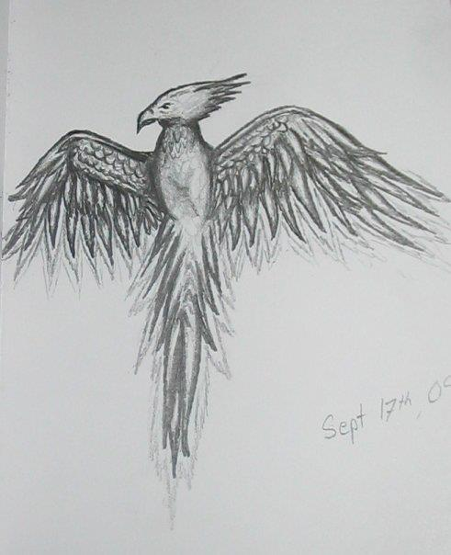
You will create a tribal tattoo Design!
Using one of the 3 designs in your sketchbook, pick 2 of them and transform it into a tribal tattoo.
You will also pick an animal you will most represents you and draw a tribal tattoo of it.
Example:
Phoenix Drawing
Phoenix Tribal Tattoo Design

Slide 32
Tattoos to help people
-Tattoos to help cancer patients

