Slide 1
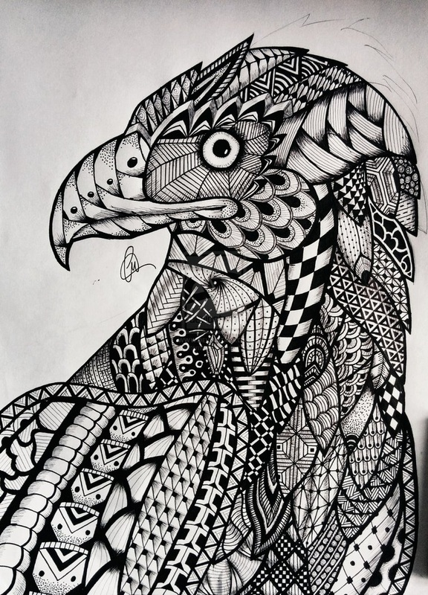
Zentangle & Contour Lines
Lesson

Slide 2
Projects & Assignments
Sketchbook Assignments:
Draw 10 types of lines in sketchbook
Draw 20 circles in a sketchbook page. Fill each circle with a different type of pattern.

Slide 3
Contour Lines
Definition:

Slide 4
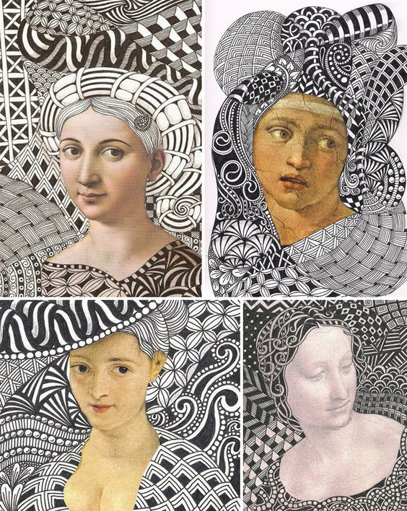
Zentangle portraits

Slide 5
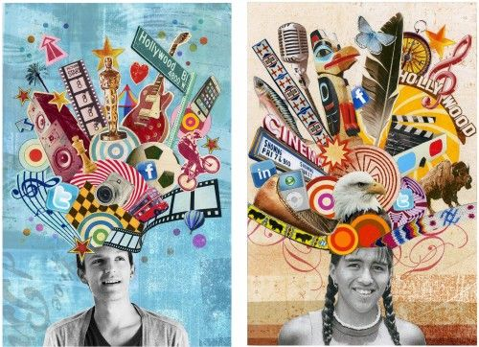
Alternative Project

Slide 6
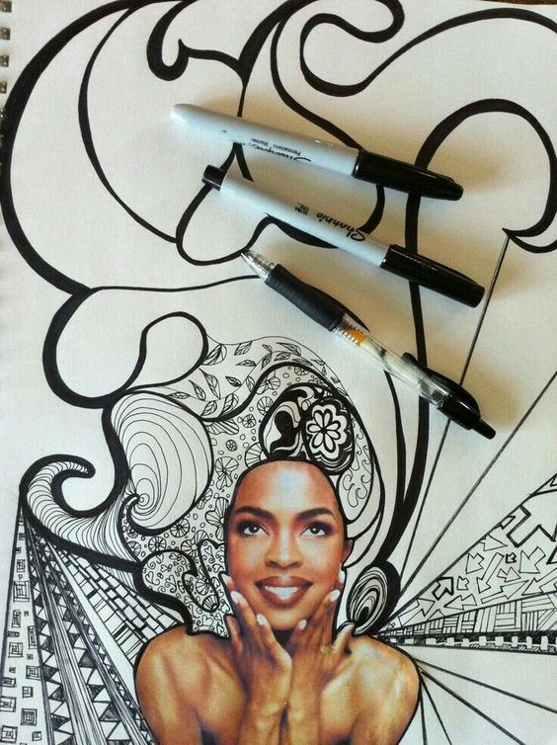
Materials
Black Sharpies
Pencil & Eraser
White Paper
Image of yourself

Slide 7
Definitions
Pattern: A continuous design
Zantangle: An abstract drawing created using repetitive patterns.
Tangle: A Zentangle pattern
Line: An element of art refering to the continuous mark made on some surface by a moving point. Contains length and direction.

Slide 8
Definitions
Geometric Shape: A shape that is precise and regular in outline. Example: circle, triangle, square.
Organic Shape: A shape that is often irregular or curved in outline, such as things in nature.

Slide 9
Definitions
Contrast: A large difference between two things, for example: hot and cold, green and red, light and shadow.
Negative space: Empty space in an artwork. A void.
Positive space: Space in an artwork that is filled with something, such as lines, color, or shape.

Slide 10
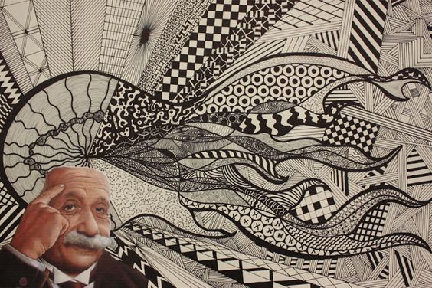

Slide 11
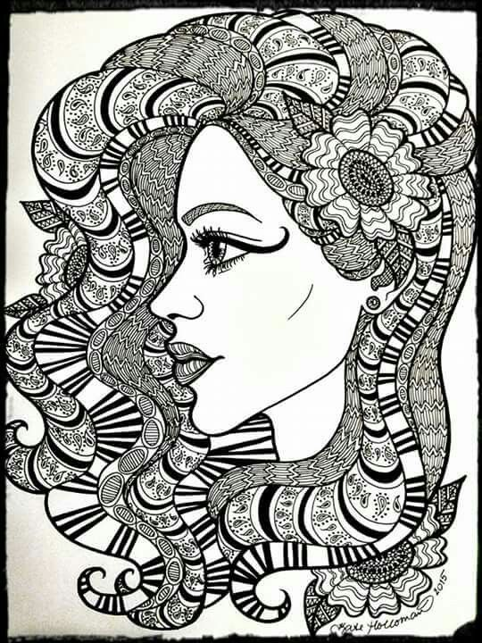
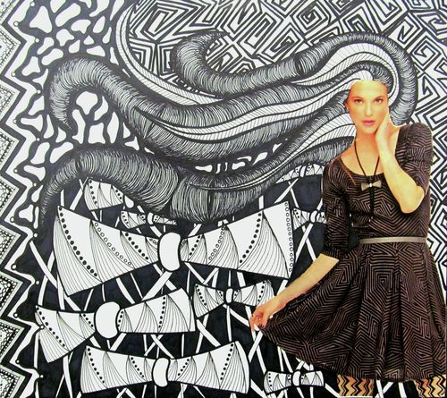

Slide 12
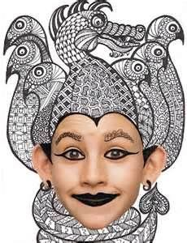
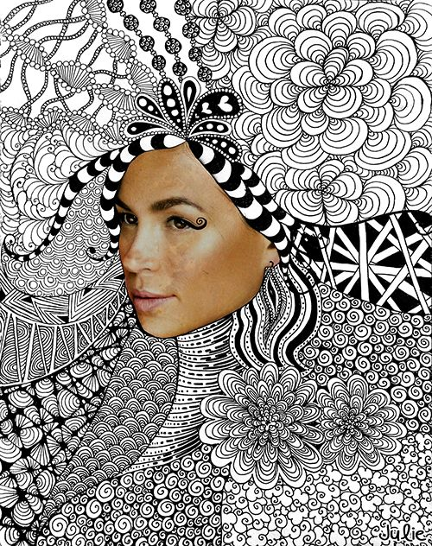

Slide 13
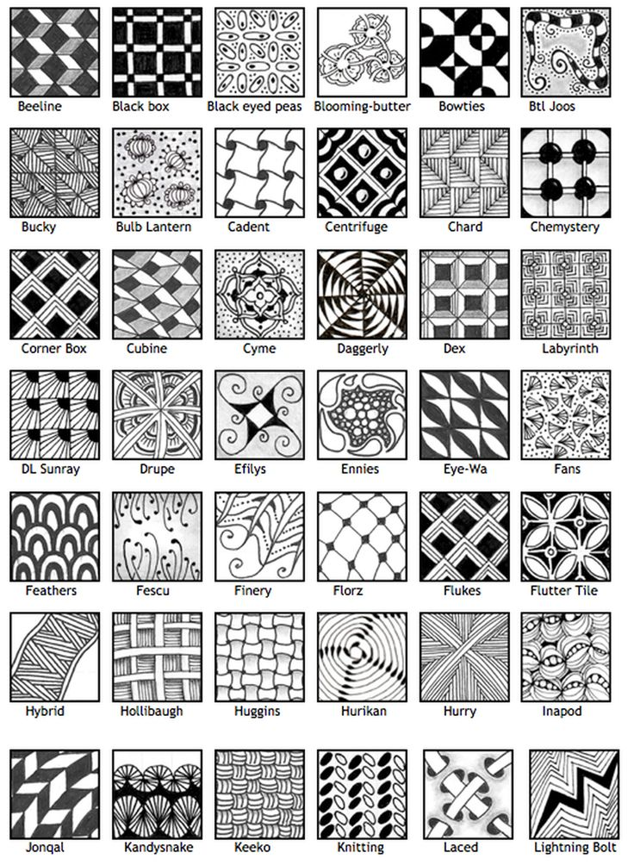
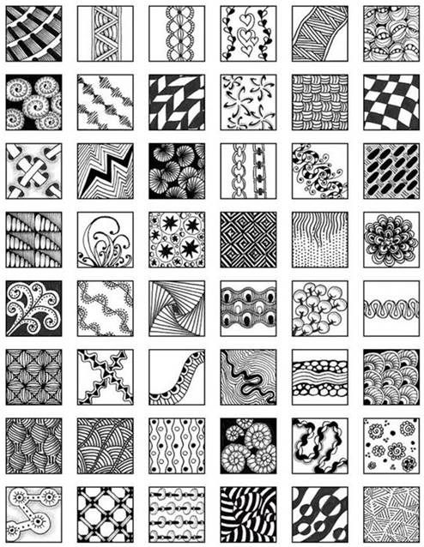

Slide 14
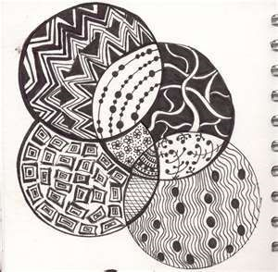
Sketchbook Assignment
Draw 4 overlapping circles.
Draw Different tangles (Patterns) for each circle part.
Must include geometric shapes and organic

Slide 15
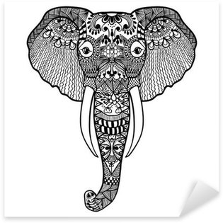
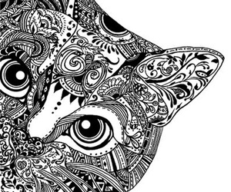
Animal Zentangle

Slide 16
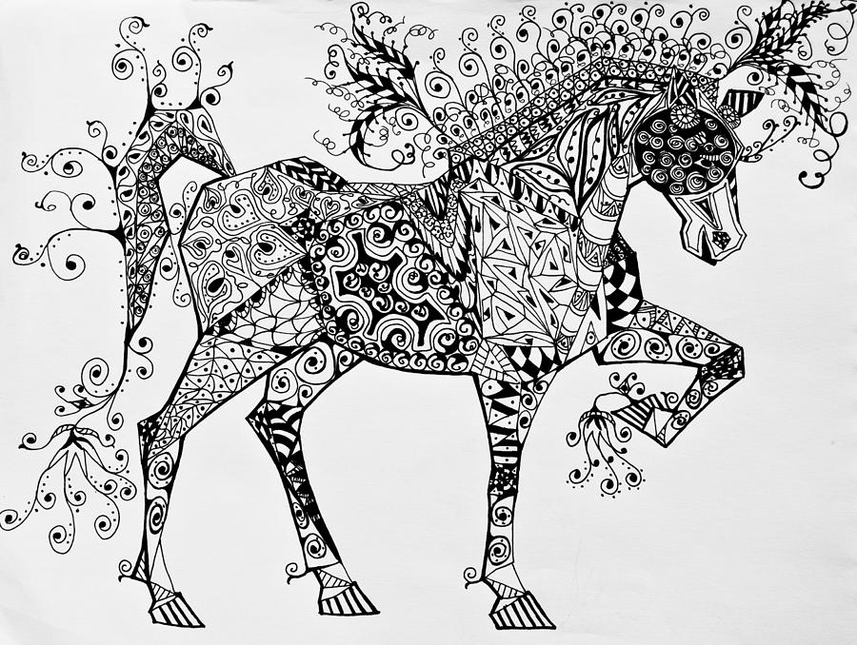

Slide 17
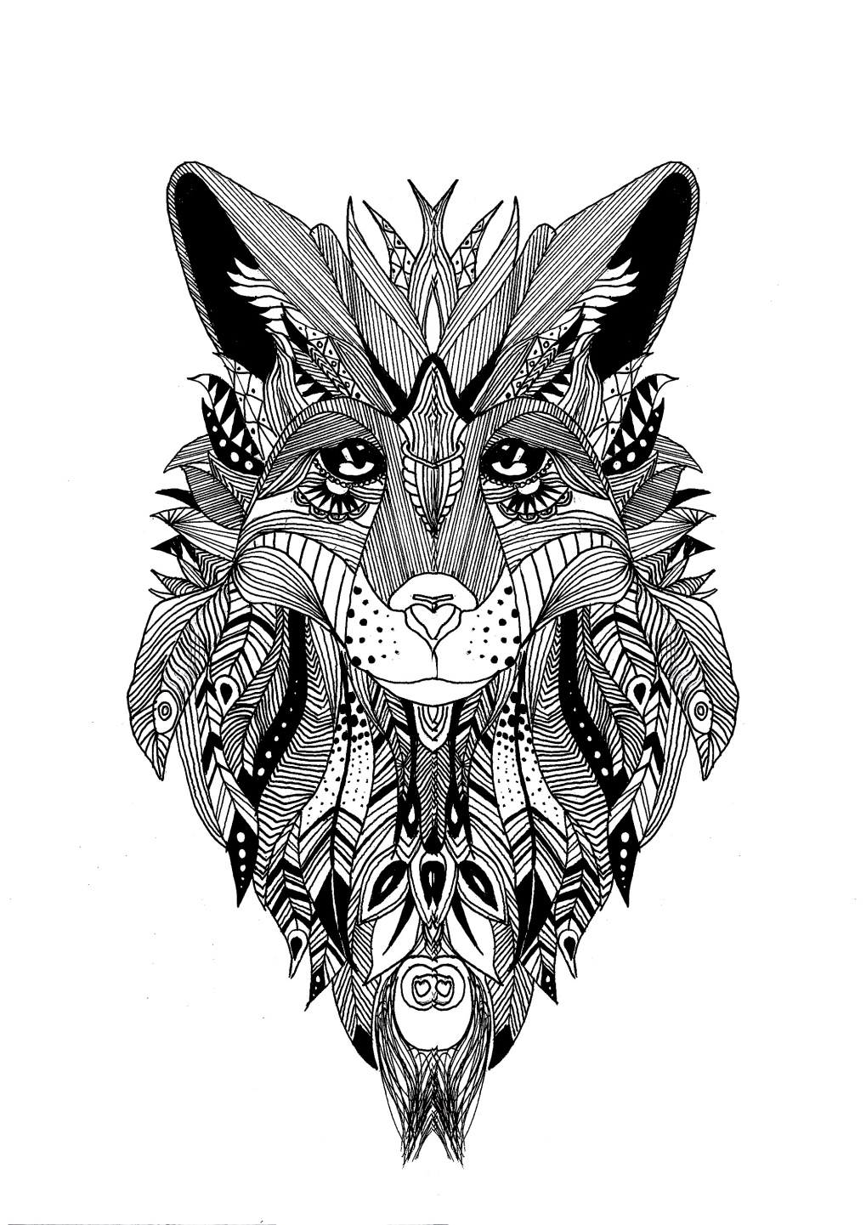
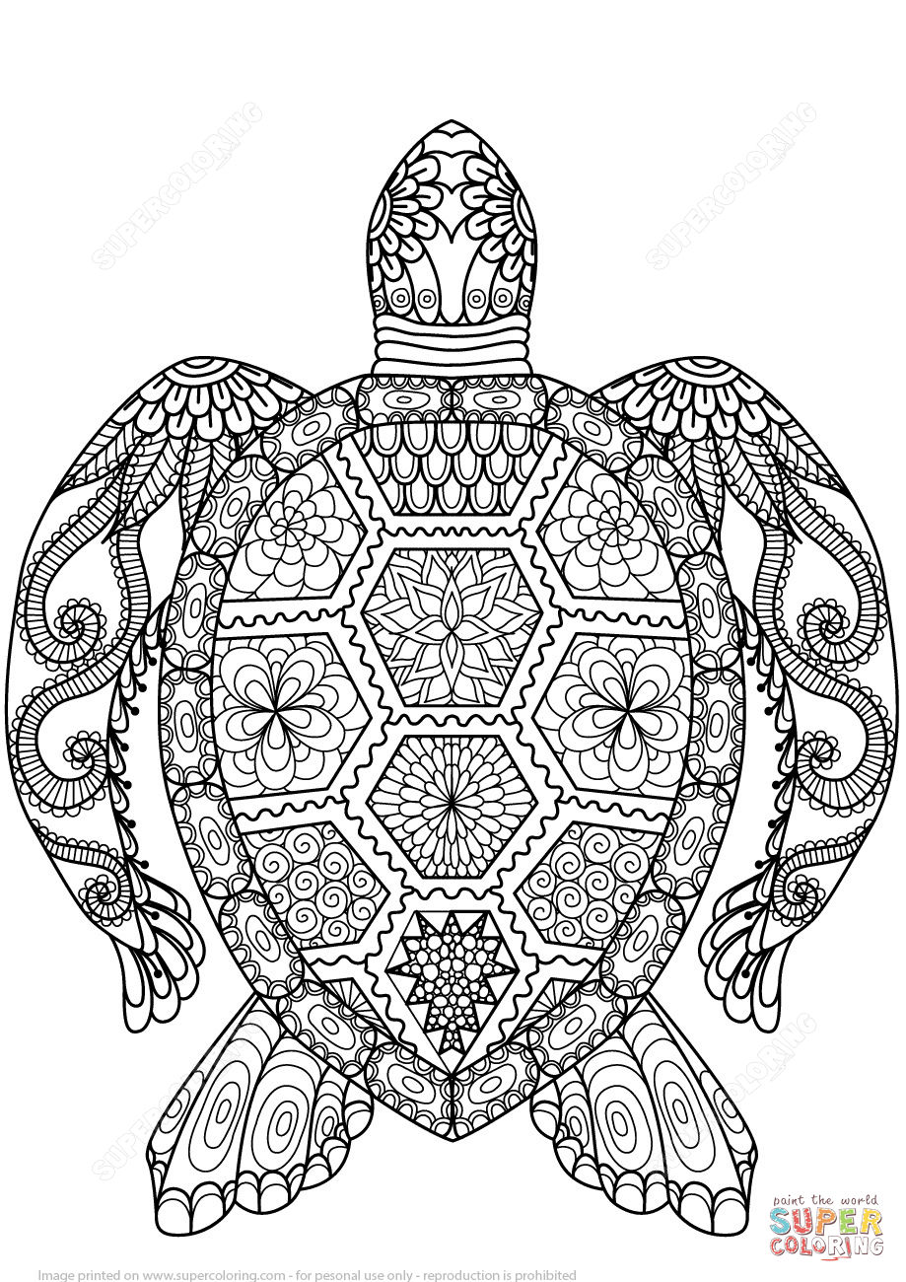

Slide 18
Artists
Maria Thomas
Rick Roberts

